Slide 1
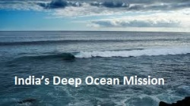
Exorsa v5.0 – (EX-200001) 17/09/17
DR. B.C. ROY ENGINEERING COLLEGE , DURGAPUR
DEEP OCEAN MISSION
Presented By : Abhishek Kumar Jha (EX-200001)

Slide 2
Exorsa v5.0 – (EX-200001) 17/09/17
SLIDE PLAN
INTRODUCTION
AIM
IMPACT
IMPLEMENTATION
CONCLUSION

Slide 3
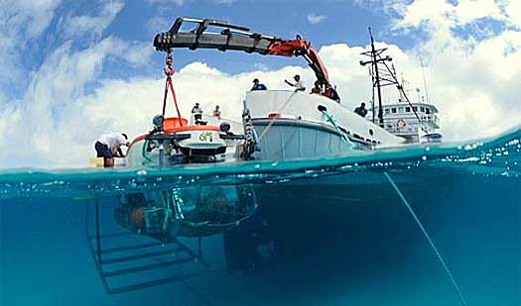
Exorsa v5.0 – (EX-200001) 17/09/17
DEEP OCEAN MISSION
.
Improve India’s position in ocean research field.
Transformative step for the prosperity and security of the nation.
Research activities in ocean science and develop technology to harness ocean resources
Fig :1 Introduction
01

Slide 4
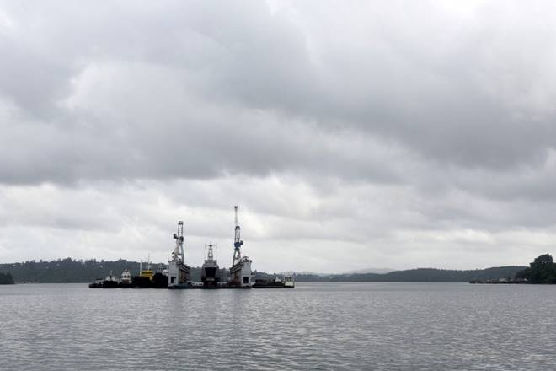
Exorsa v5.0 – (EX-200001) 17/09/17
AIM
Enhance Security
Explore Minerals of sea
Research activities in
ocean science
Fig : 2 AIM
02

Slide 5
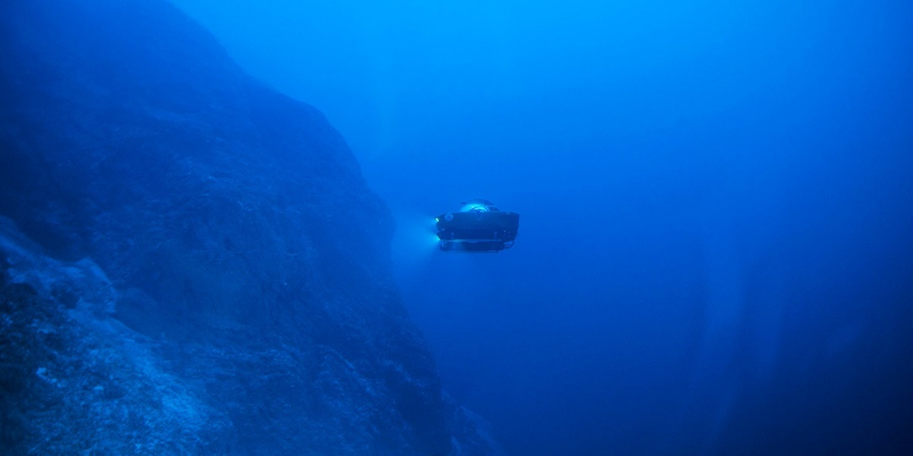
Exorsa v5.0 – (EX-200001) 17/09/17
Impact
Help to harness resources of ocean
Improve the security of nation
Help to study the cyclone cause by increased temperature
Fig : 2 IMPACT
03

Slide 6
Exorsa v5.0 – (EX-200001) 17/09/17
Implementation
Research will be done by the scientists of CSIR-NIO,
Ambitious Rs 10,000-crore
Project
Ship building by Titagarh Wagons Ltd,
04

Slide 7
Exorsa v5.0 – (EX-200001) 17/09/17
CONCLUSION
Improve the ocean security
Improve Efficient extraction of minerals
Research on rising temperature of sea
10

Slide 8
Thank You...

