Slide 1
SARAHAH
A global sensation

Slide 2
What is it?
SARAHAH is an UAE based mobile app.
The mastermind behind this app is Zain al-Abdin Iqbal
The main purpose of this app is to allow people to anonymously encourage and inspire others by texting them.
It has risen to fame recently

Slide 3
BENEFITS:
It allows one to choose one’s audience and spread a positive vibe around them.

Slide 4
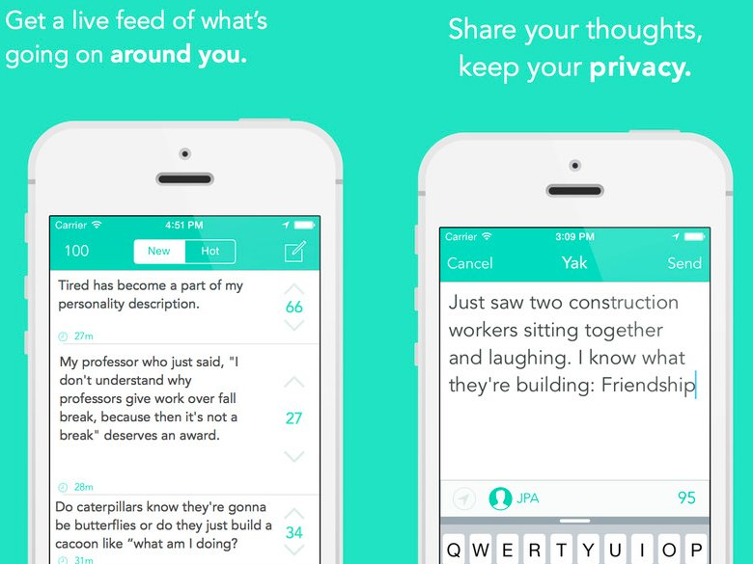
Spreading a positive vibe
Here people help others in their problems and hence it effectively counters depression and stress in the most basic way
People write positive stuff about others,making the receiver of the message happy and also the sender of the message satisfied.in a world where people have started using slang words and colliqual language very often,it would work on the mind of people subcontiously to reduce the usage due to greater exposure to positivity.

Slide 5
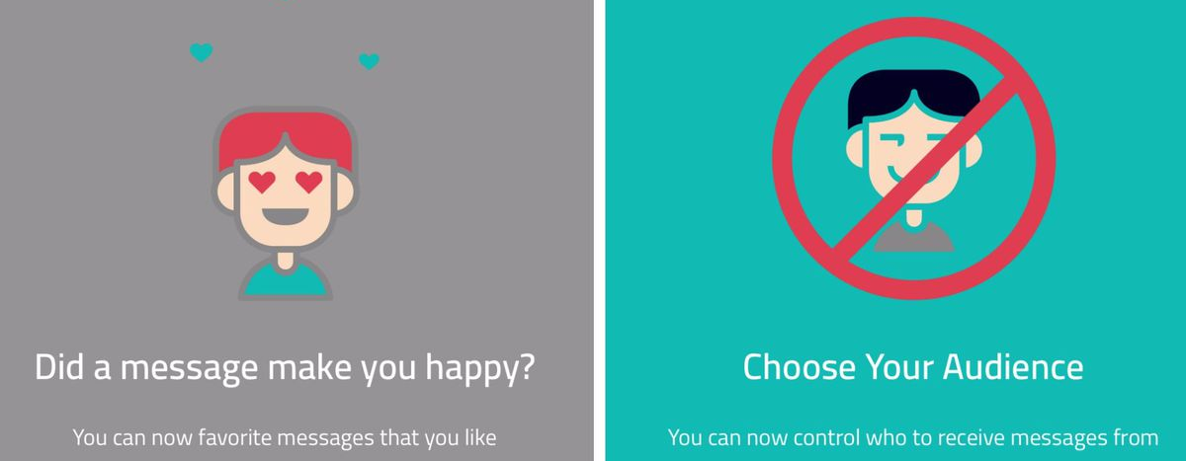
One can decide the kind of people that can reply to them ,which if done properly can be used to avoid trolls

Slide 6
Disadvantages:
People are difficult to change.it is feared that despite the efforts,one cannot avoid trolls and cyberbullying

Slide 7
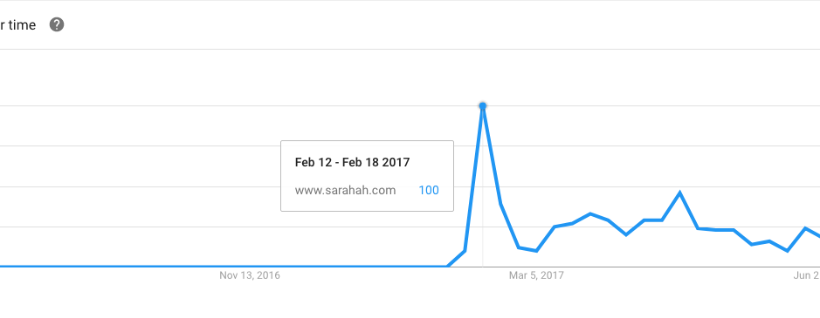
The increase in popularity has been phenomenal.
Source:mashable

Slide 8

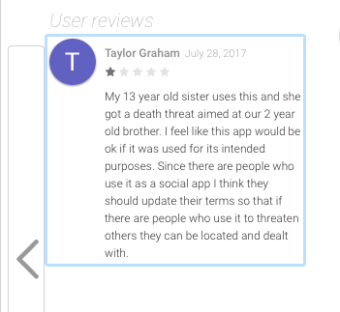
Cyber bullying
It has made an valiant effort to make things better for people,but has not been spared from cyberbullying either,which defeats the purpose of the app.

Slide 9
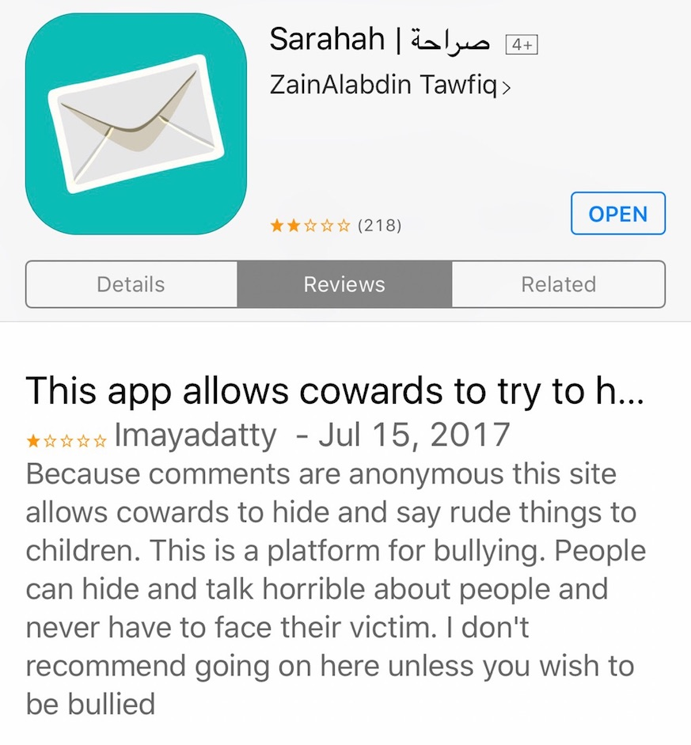

trolls
Anonymity is being misused to make cheap comments by people.

