Slide 1
FIFA U-17 World Cup

Slide 2
History
First hosted by China PR in 1985, was founded as FIFA U-16 World Championship..
From the 4th edition onwards, FIFA increased the age limit from U-16 to U- 17 and it came to be known as U-17 World Championship in 1991

Slide 3
Time Gap
Years

Slide 4
Route to U-17 World Cup
Local Community Games
Best Clubs of the Country
Best teams from the 6 confederations

Slide 5
Confederations Perspective
Confederations | Championships
AFC (Asia) | AFC U-16 Championship
CAF (Africa) | African Under-17 Championship
CONCACAF (North, Central America and Caribbean) | CONCACAF Under-17 Championship
CONMEBOL (South America) | South American Under-17 Football Championship
OFC (Oceania) | OFC U-17 Championship
UEFA (Europe) | UEFA European Under-17 Football Championship

Slide 6
Reservation criteria
One slot is automatically reserved for
The Hosting Nation

Slide 7
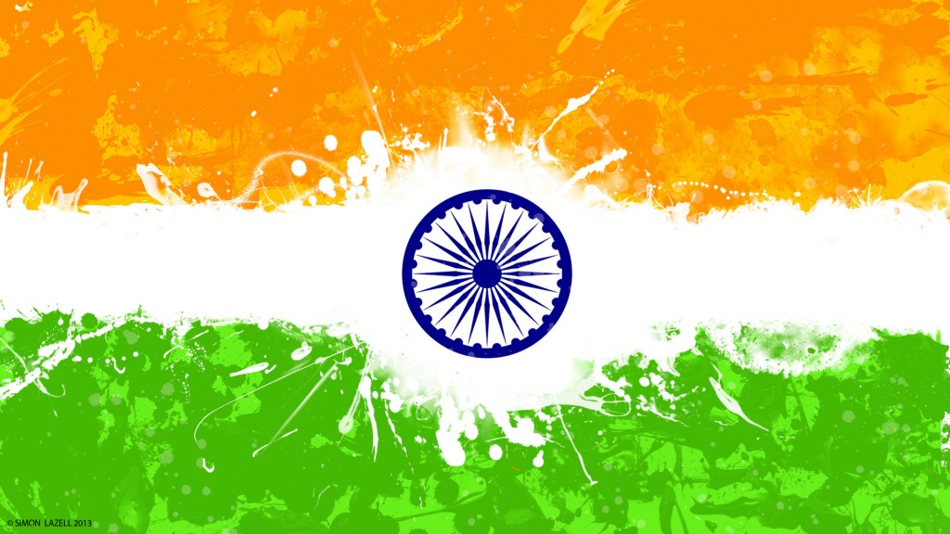
Hosting Country

Slide 8
Number of Matches
Games will be played to decide the winner of the FIFA U-17 World Cup India 2017.

Slide 9
Commencement
October

Slide 10

Official Mascot 2017 - Kheleo

Slide 11


